Slide 1
Binomial Distribution
Prepared by
Sajana Shakya

Slide 2
Binomial Distribution:
It is based on Bernoulli trials. A Bernoulli trial is an experiment having only two possible outcomes, that is success or failure. For eg. Tossing of a coin (head/tail) , firing a target (hit,miss), playing a game (win/lose) etc.

Slide 3
Binomial Distribution
Conditions:
The experiment consists of n repeated trials.
Every trial has two possible outcomes. That is success and failure.
The probability of success p is same on every trial.
The trials are independent.

Slide 4
Then let X be a discrete random variable which represents number of successes observed from binomial experiment. Then the random variable X is called binomial random variable.
For example: Tossing a coin 3 times.
S={HHH, HHT,HTH,THH,HTT,THT,TTH,TTT}

Slide 5
Here,
1) n=3
2) Head/Tail
3)Prob.(H)=1/2
4) Every trial is independent.
X=> number of heads
X= 0,1,2,3

Slide 6
Prob.(X=0)=P(TTT)
= P(T).P(T).P(T)
=(1/2)*(1/2)*(1/2)
=1/8
=1 *(1/2)⁰ (1/2)³
= C(3,0) (1/2)⁰ (1/2)³
Prob.(X=1)=P(HTT)+P(THT)+P(TTH)
=1/8+1/8+1/8
=3/8
=3*(1/2)¹ (1/2)²
⁼C(3,1) (1/2)¹ (1/2)² in general,
P(X=x)= C(n, x) p^{x} q^{n-x} =>p. m. f. of Binomial distribution

Slide 7
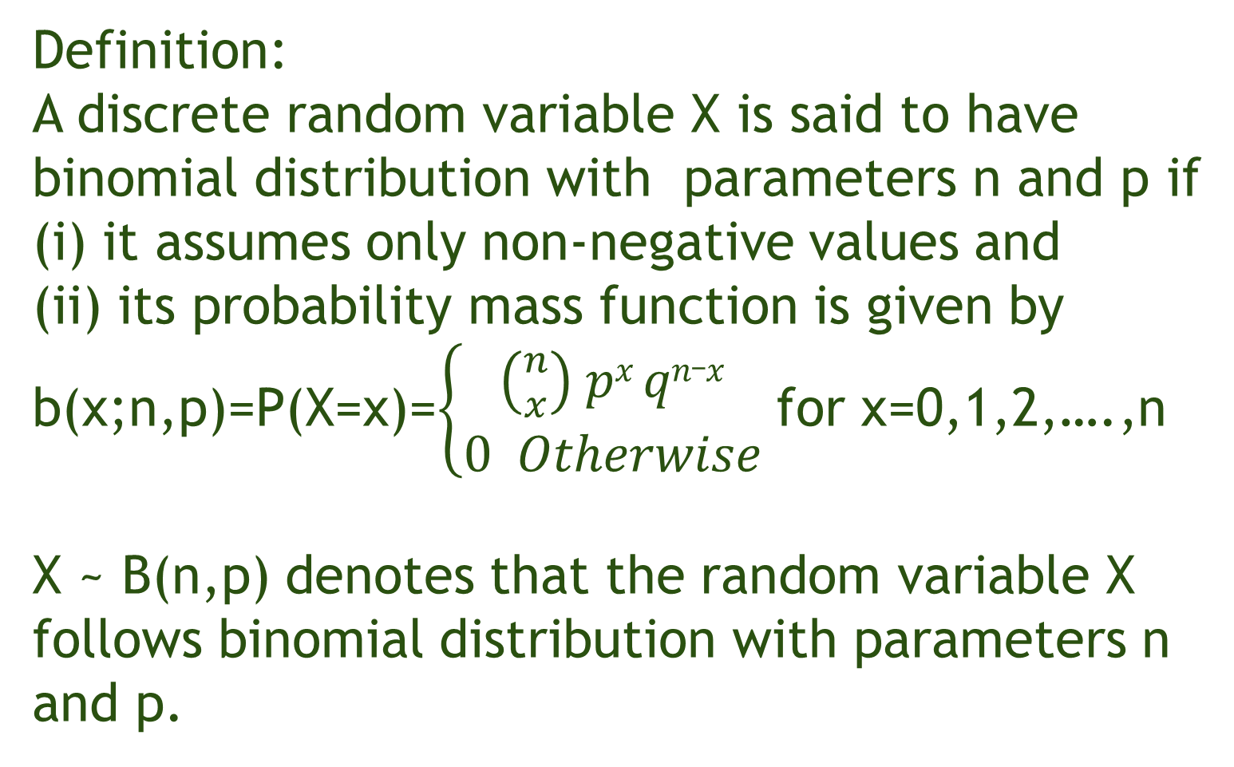
Definition:
A discrete random variable X is said to have binomial distribution with parameters n and p if
(i) it assumes only non-negative values and
(ii) its probability mass function is given by b(x;n,p)=P(X=x)=$\left\{\begin{aligned}\left({n \atop x}\right) px qn_x \\ 0 Otherwise\end{aligned}\right.$ for x=0,1,2,….,n
X ~ B(n,p) denotes that the random variable X follows binomial distribution with parameters n and p.

Slide 8
Eg: Multiple choice questions
1. a 2.a 3. a 4. a b b b b c c c c d d d d e e e e

Slide 9
Here,
1) n=4
2) Correct/Wrong
3)Prob.(C)=1/5
4) Every question is independent.
X=> number of correct answers
X= 0,1,2,3,4
F(3)=P(X≤3)=P(X=0)+P(X=1)+P(X=2)+P(x=3) which is cumulative probability for Binomial distribution. c.d.f->F(x)=P(X≤x)=P(X=0)+P(X=1)+P(X=2)+………+P(X=x)

Slide 10
What is the average number of correct answer?
Mean and Variance of Binomial distribution are
Mean E(X)=np
=4*(1/5)
=0.8
Variance V(X)=npq
=4*(1/5)*(4/5)
=0.64

Slide 11
Properties of Binomial Distribution
It is discrete probability distribution.
It assumes only non-negative values i.e. 0,1,2,3,……….,n
It has two parameters n and p. If n and p are known, the binomial distribution can be completely determined.
Its mean and variance are np and npq.
Mean > variance
It is symmetrical if p=q=0.5
It is negatively skewed if p>0.5
It is positively skewed if p<0.5
Binomial distribution tends to normal distribution as n increases.

Slide 12
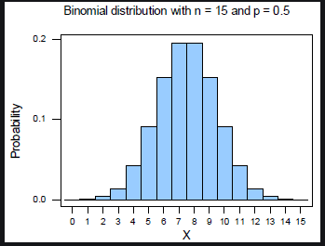
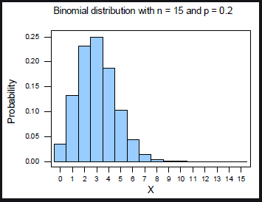
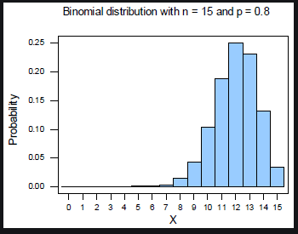

Slide 13
Problem 1:
It is observed that 80% of television viewers watch entertainment channel. What is the probability that at least 80% of the viewers in a random sample of five watch entertainment channel?

Slide 14
Problem 2:
The probability of a bomb hitting a target is 0.20. Two bombs are enough to destroy a bridge. If six bombs are aimed at the bridge, find the probability that the bridge is destroyed.
Problem 3:
If the mean and variance of a binomial distribution are 3 and 3/2 find the probability of at least 4 successes.

Slide 15
Problem 4:
Out of 800 families of Kathmandu with 4 children each, what percentage would be expected to have a)2 boys and 2 girls b)at least one boy c) no girls and d) at most 2 girls.
Assume equal probabilities for boys and girls.

Slide 16
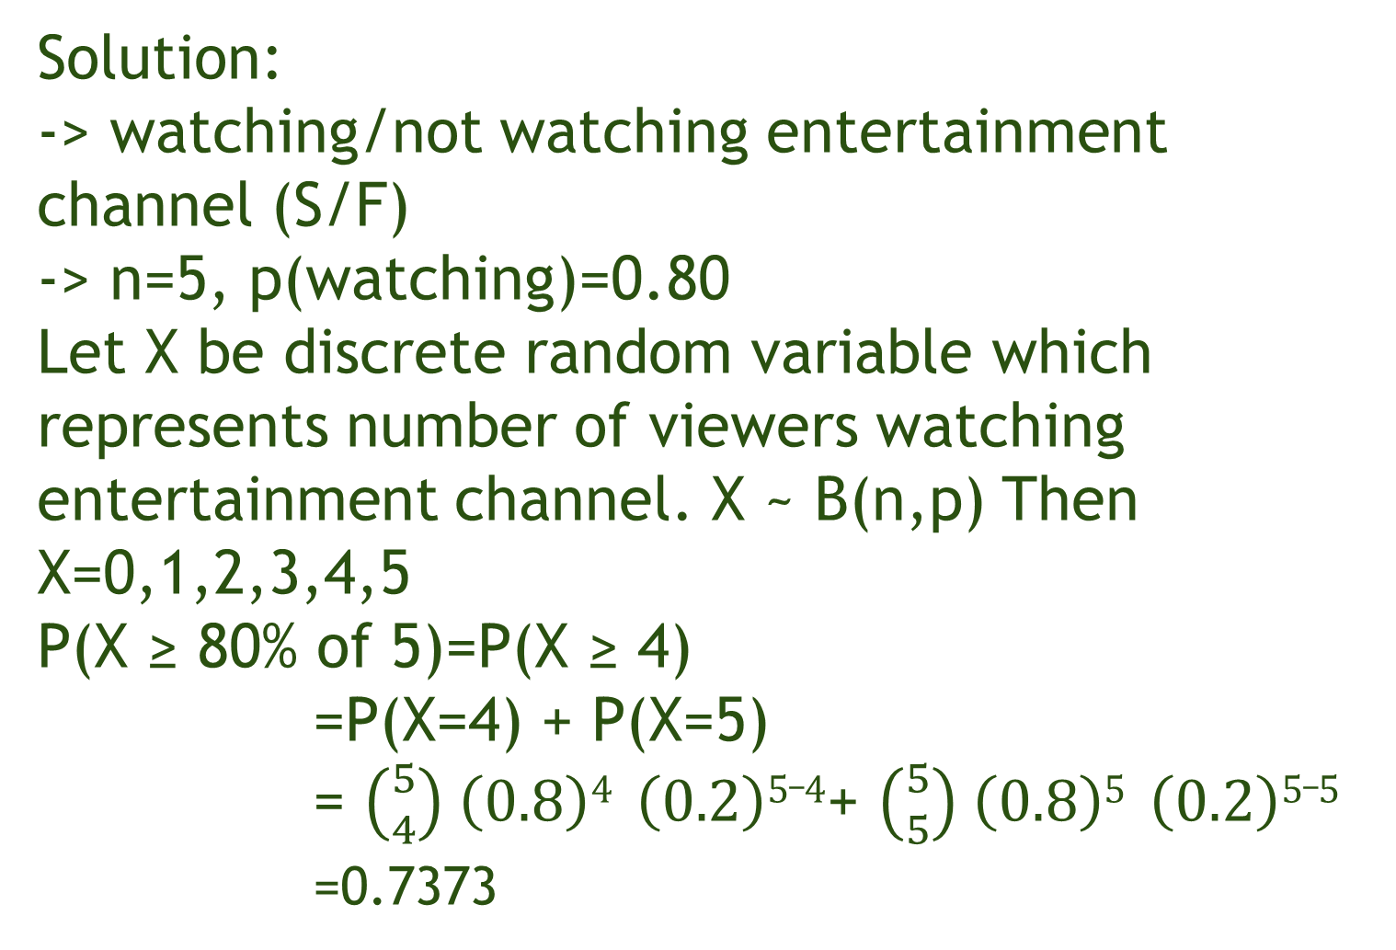
Solution:
-> watching/not watching entertainment channel (S/F)
-> n=5, p(watching)=0.80
Let X be discrete random variable which represents number of viewers watching entertainment channel. X ~ B(n,p) Then
X=0,1,2,3,4,5
P(X ≥ 80% of 5)=P(X ≥ 4)
=P(X=4) + P(X=5)
= $\left({5 \atop 4}\right) \left(0.8\right)4 \left(0.2\right)5_4$+ $\left({5 \atop 5}\right) \left(0.8\right)5 \left(0.2\right)5_5$
=0.7373

